Slide 1
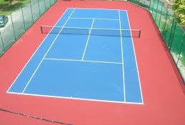
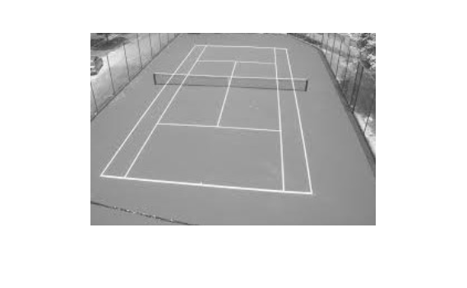
STEPS
1st---change to the BW pictures | This can help us easy to deal with the pictures. We can minus two pictures to find the edge
2ND---find the lines and light it | Because this is used for finding the lines, so we highlight the line with hough method.
3rd---change the line into one point and list on the graph to find the relationship of the points | We can find that: The lines are all change into a point. And the x-axis and y-axis have the meaning of the length and the angle of the line. We can use the graph to find the characters of the lines. Since the tennis square have straight lines so we can detect easily. If the character of the things is easy to detect, this method will be more useful.
Gao Tianqi

